Slide 1
Logging our data
DBMan: Handles all traffic to and from the database
BASIC FUNCTIONALITY
  Collects data from sensor servers
  For now: gets other data from weather service
    Like: humidity, current weather
  Stores data sets in DB
  Is connected to Spouts, provides data to them

Slide 2
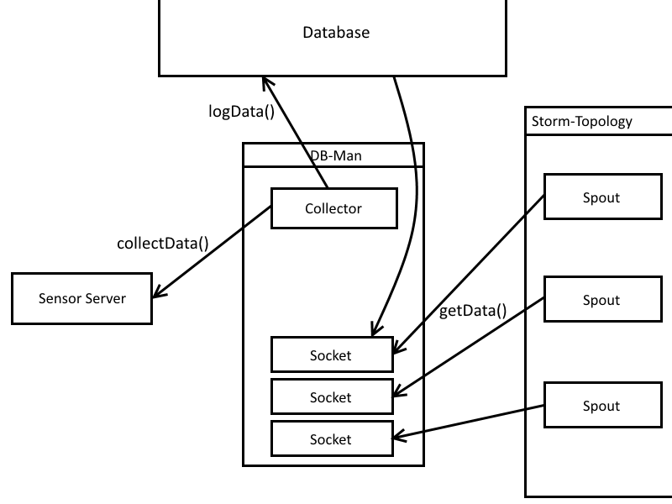
Logging our data

Slide 3
Why bother with a data base?
Storm may be hard to kill, but:
  Proper training of classifier takes time
  Topology would have to run constantly
  New classifier forces restart

